Slide 1
Image Super Resolution
ADS-project3-group3
Yuting He, Seungwook Han, Shengwei Huang, Mengran Xia, Hongye Jiang

Slide 2
Goal
Our goal is to use machine learning method to create predictive models to enhance the blurry and low-resolution images so that we can get high resolution images.

Slide 3
Outline
Feature Extraction
Performance Measure
Baseline Model
Advanced Model
Outcome Comparison

Slide 4
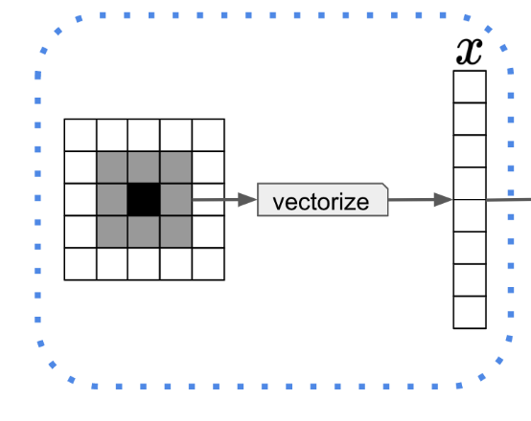
Feature Extraction
Extract eight neighbors of every pixel as its features.

Slide 5
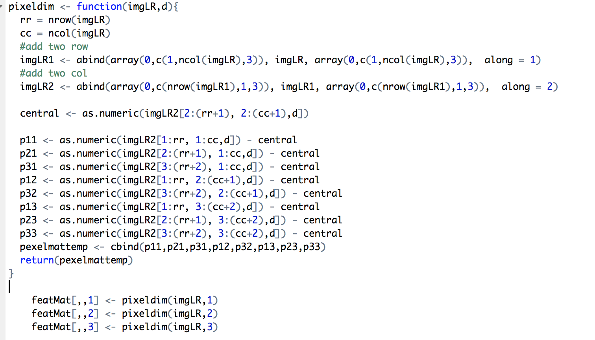
PADDING ZEROS
Extract neighbors
Centralization

Slide 6
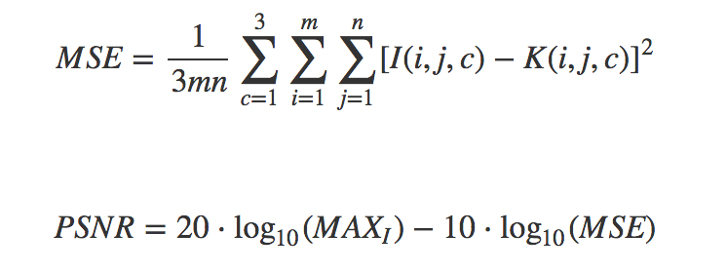
II. Performance Measure

Slide 7
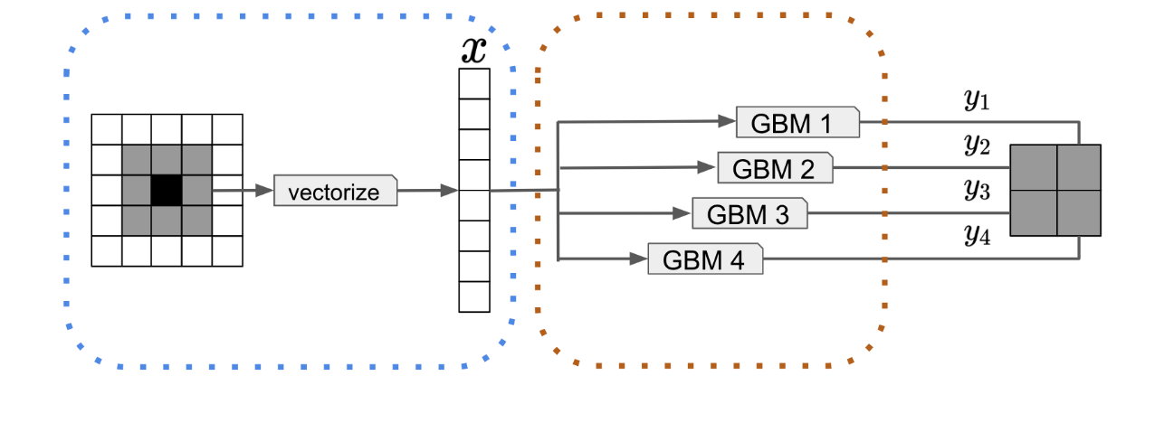
III. Baseline Model

Slide 8
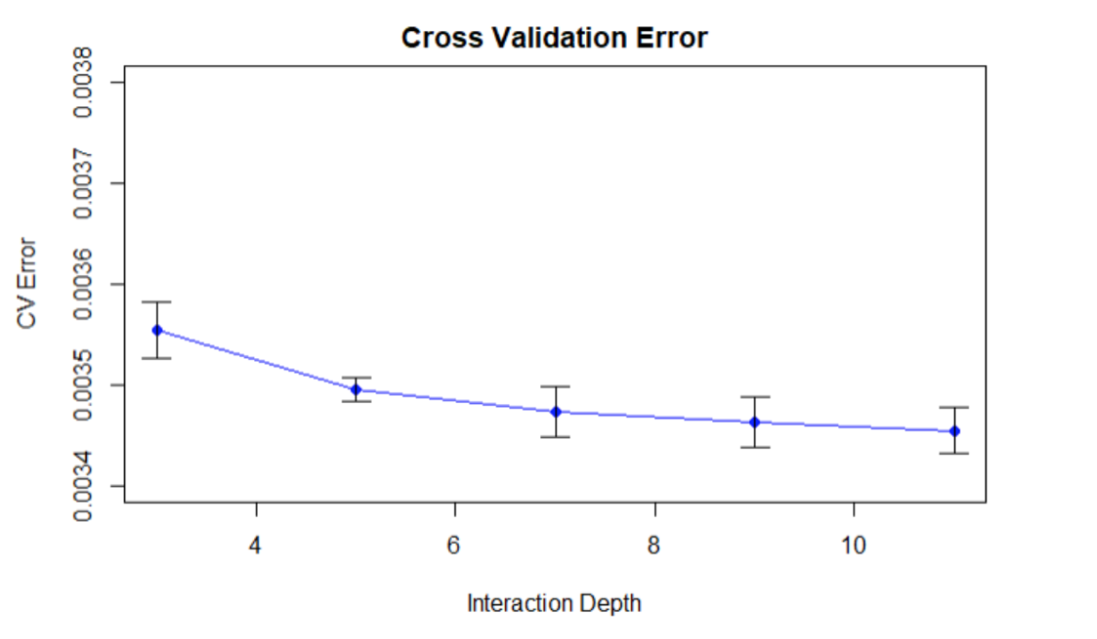
Cross validation

Slide 9
Baseline Performance
Depth = 11
Mean MSE | Mean PSNR
0.002511598 | 27.05948

Slide 10
IV. Advanced Model——XGBoost
Different booster comparison
 | Mean MSE | Mean PSNR
GBTREE | 0.002593127 | 27.03771
GBLINEAR | 0.002511576 | 27.05951
DART | 0.011715 | 19.42583

Slide 11
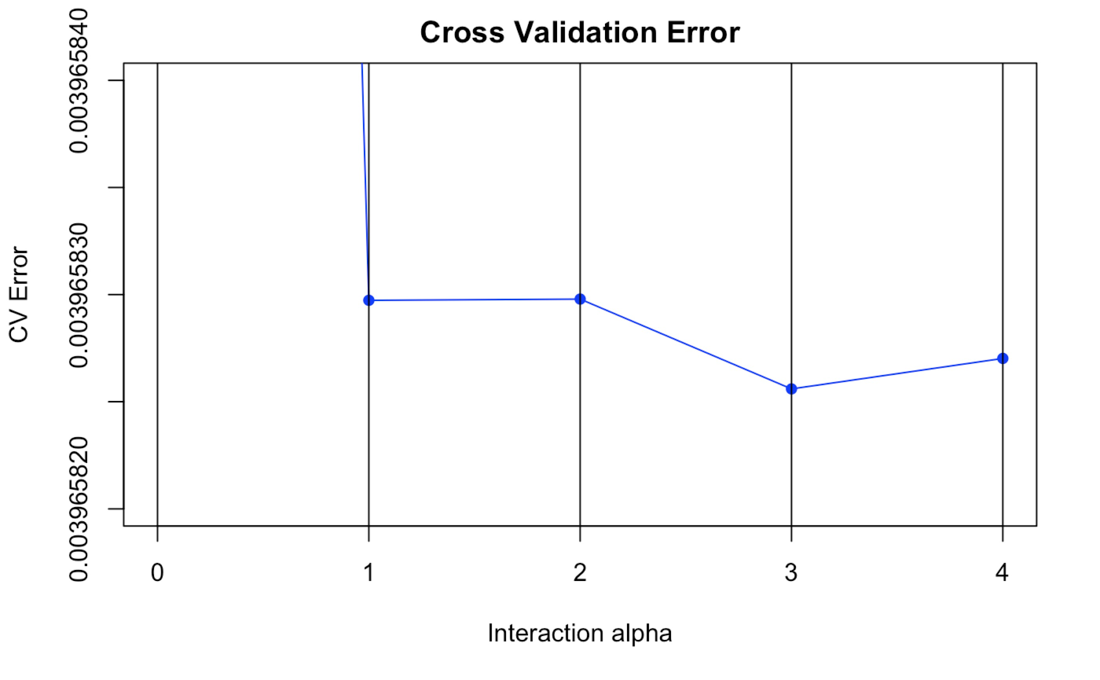
IV. Advanced Model——XGBoost
Cross validation for alpha
Alpha = 3
L1 regularization term on weights. Increasing this value will make model more conservative. Normalised to number of training examples.

Slide 12
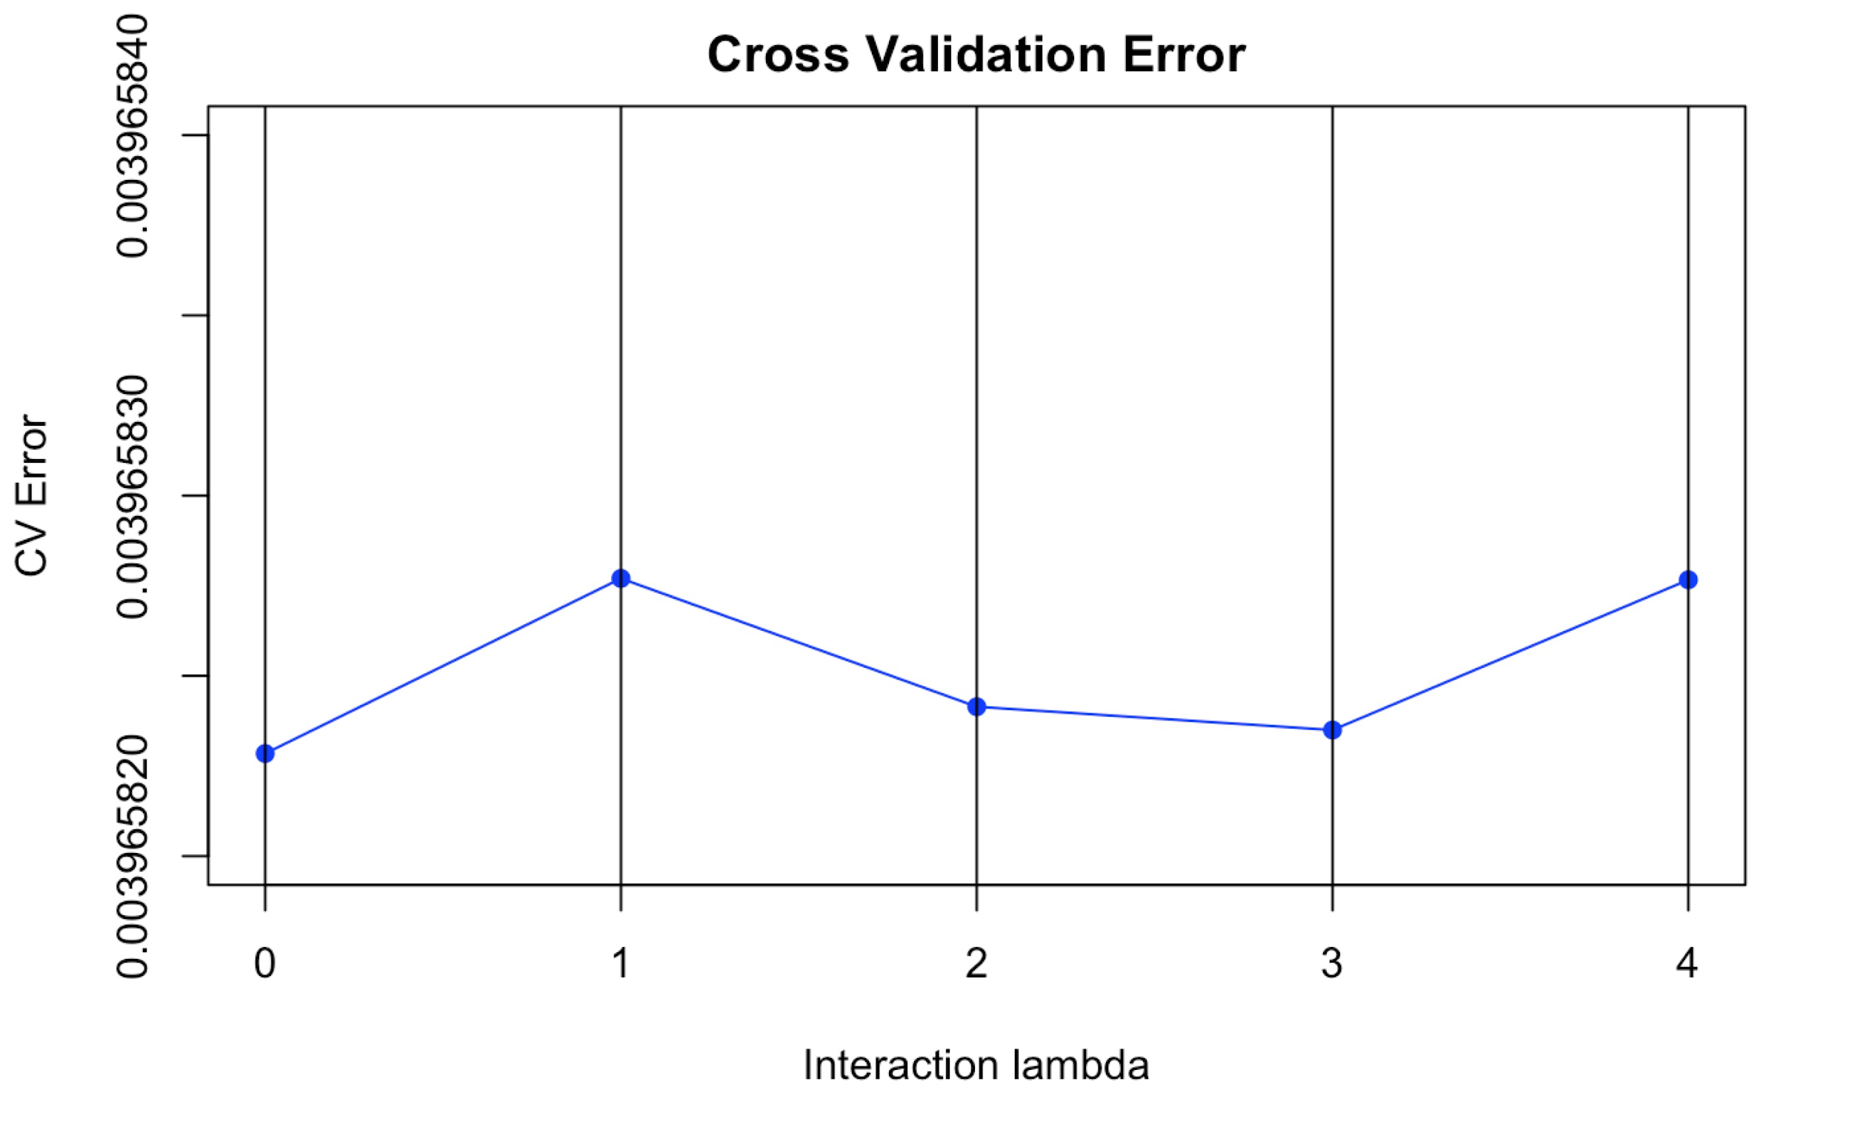
IV. Advanced Model——XGBoost
Cross validation for lambda
Lambda = 0
L2 regularization term on weights. Increasing this value will make model more conservative. Normalised to number of training examples.

Slide 13
V. Outcome Comparison
 | Baseline Model | XGBoost
Mean MSE | 0.002511598 | 0.002511576
Mean PSNR | 27.05948 | 27.05951
 | Baseline Model | XGBoost
Training time | > 5 h | 47.453 s
Testing time | 102.248 s | 11.602 s

Slide 14


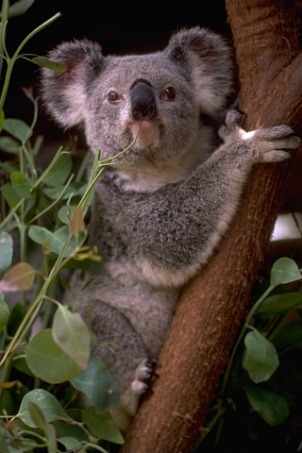
V. Outcome Comparison
Low resolution
Baseline model
XGBoost model
High resolution

Slide 15
Why XGBoost fast and accurate?
Speed:
Accuracy:
XGBoost utilizes OpenMP which can parallel the code on a multithreaded CPU automatically.
XGBoost has defined a data structure DMatrix to store the data matrix. This data structure will perform some preprocessing work on the data so that the latter iteration is faster.
The main reason for the improvement of the accuracy is because the newly-defined regularization term and the pruning approach which makes the learned model more stable.

Slide 16
Thanks!

